Slide 1
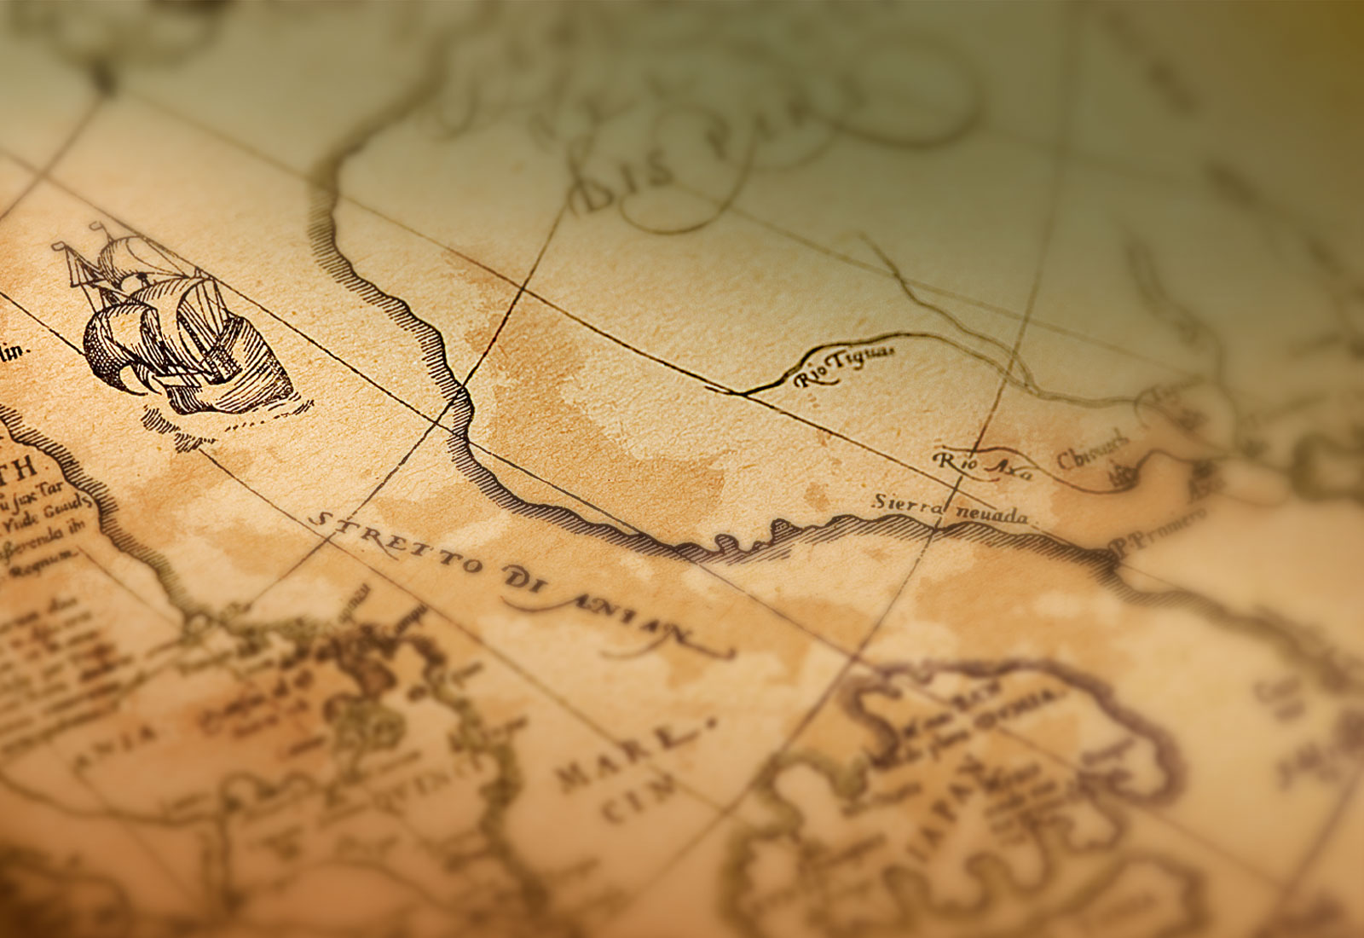
TIMETRAVlR
Anthony Amedome
James O’Keefe
Rehan Hussain
Matthias Borges

Slide 2
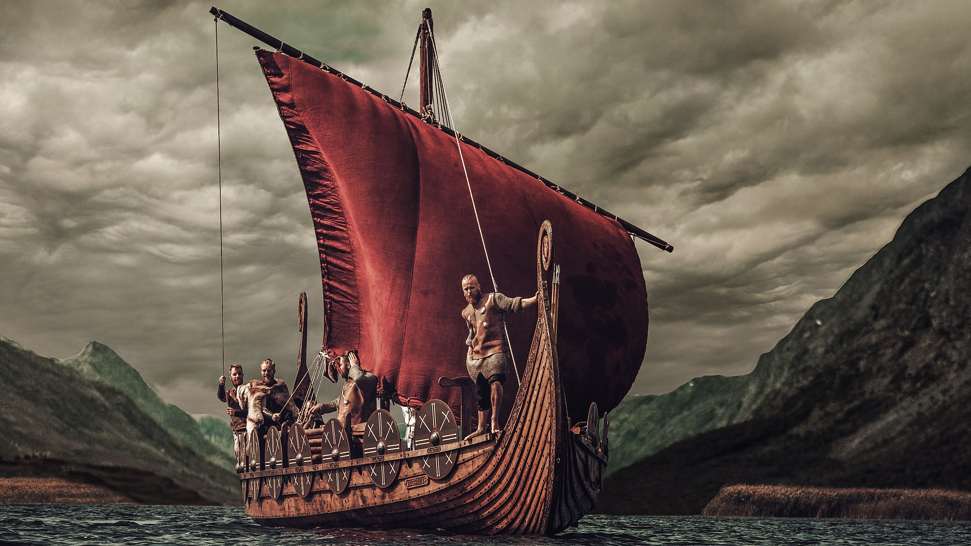

Slide 3
TIMETRAVLR is a game inspired by GeoGuessr,
TIMETRAVLR is a game inspired by GeoGuessr, but instead of guessing places on the globe based off images,
TIMETRAVLR is a game inspired by GeoGuessr, but instead of guessing places on the globe based off images, you guess what period of history an image took place in.
TIMETRAVLR is a game inspired by GeoGuessr, but instead of guessing places on the globe based off images, you guess what period of history an image took place in. There are 13 periods of history to guess from, including the future.

Slide 4
Categories to choose from include:

Slide 5
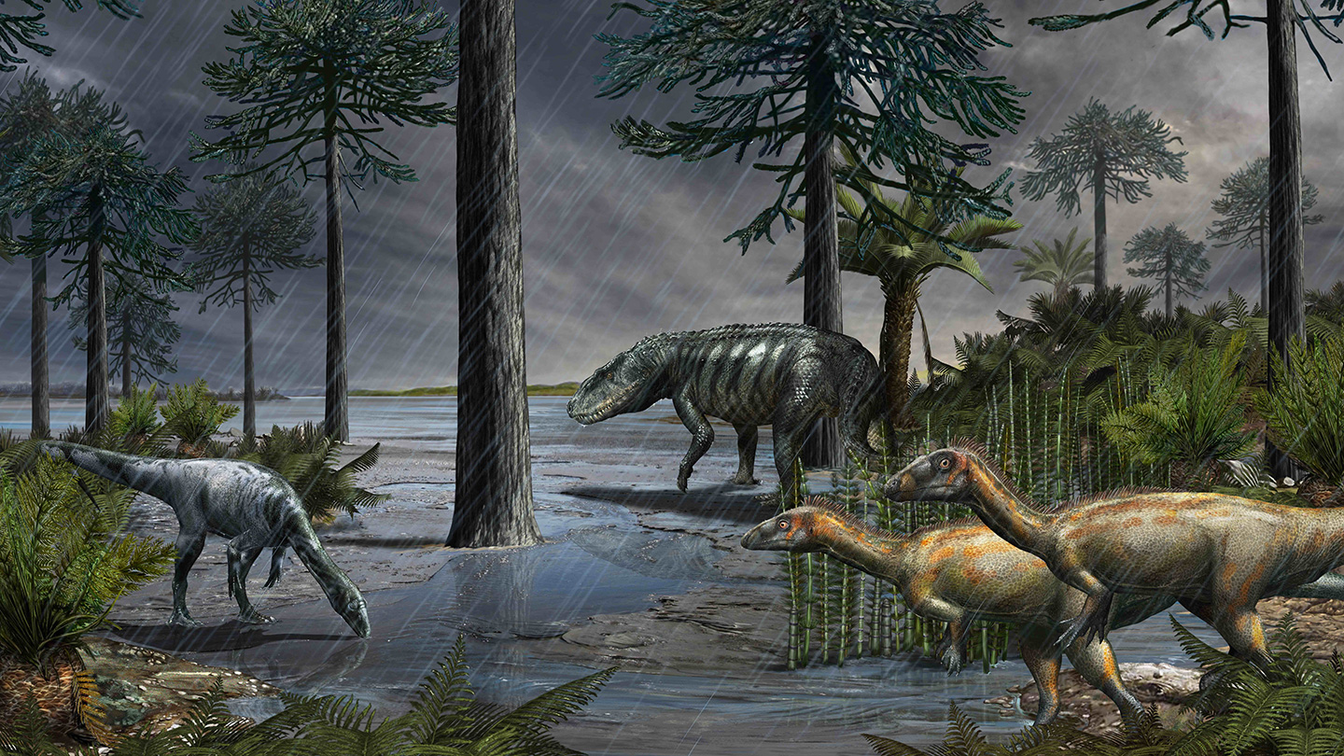
Categories to choose from include:
The Era of Dinosaurs

Slide 6
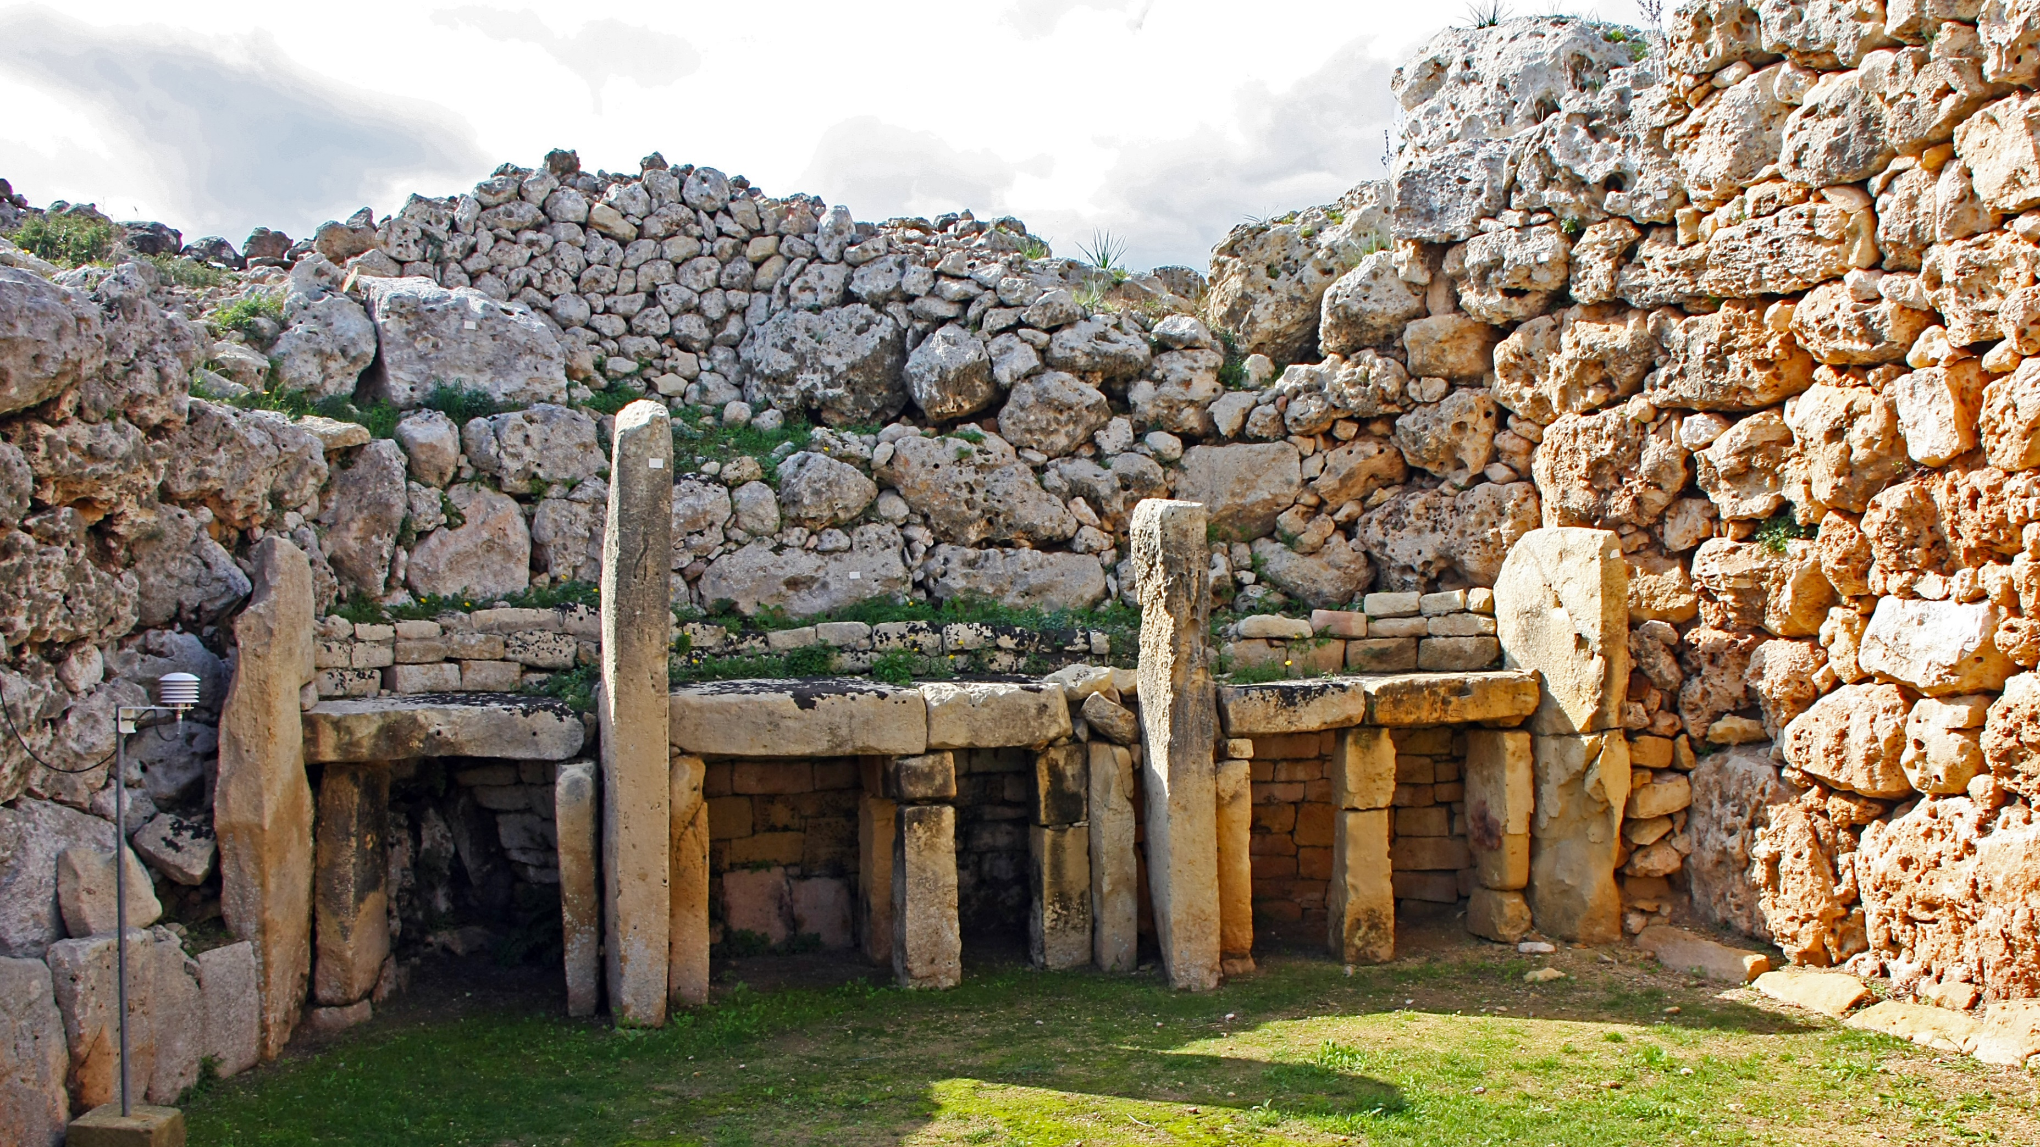
Categories to choose from include:
The Era of Dinosaurs
The Stone Age

Slide 7
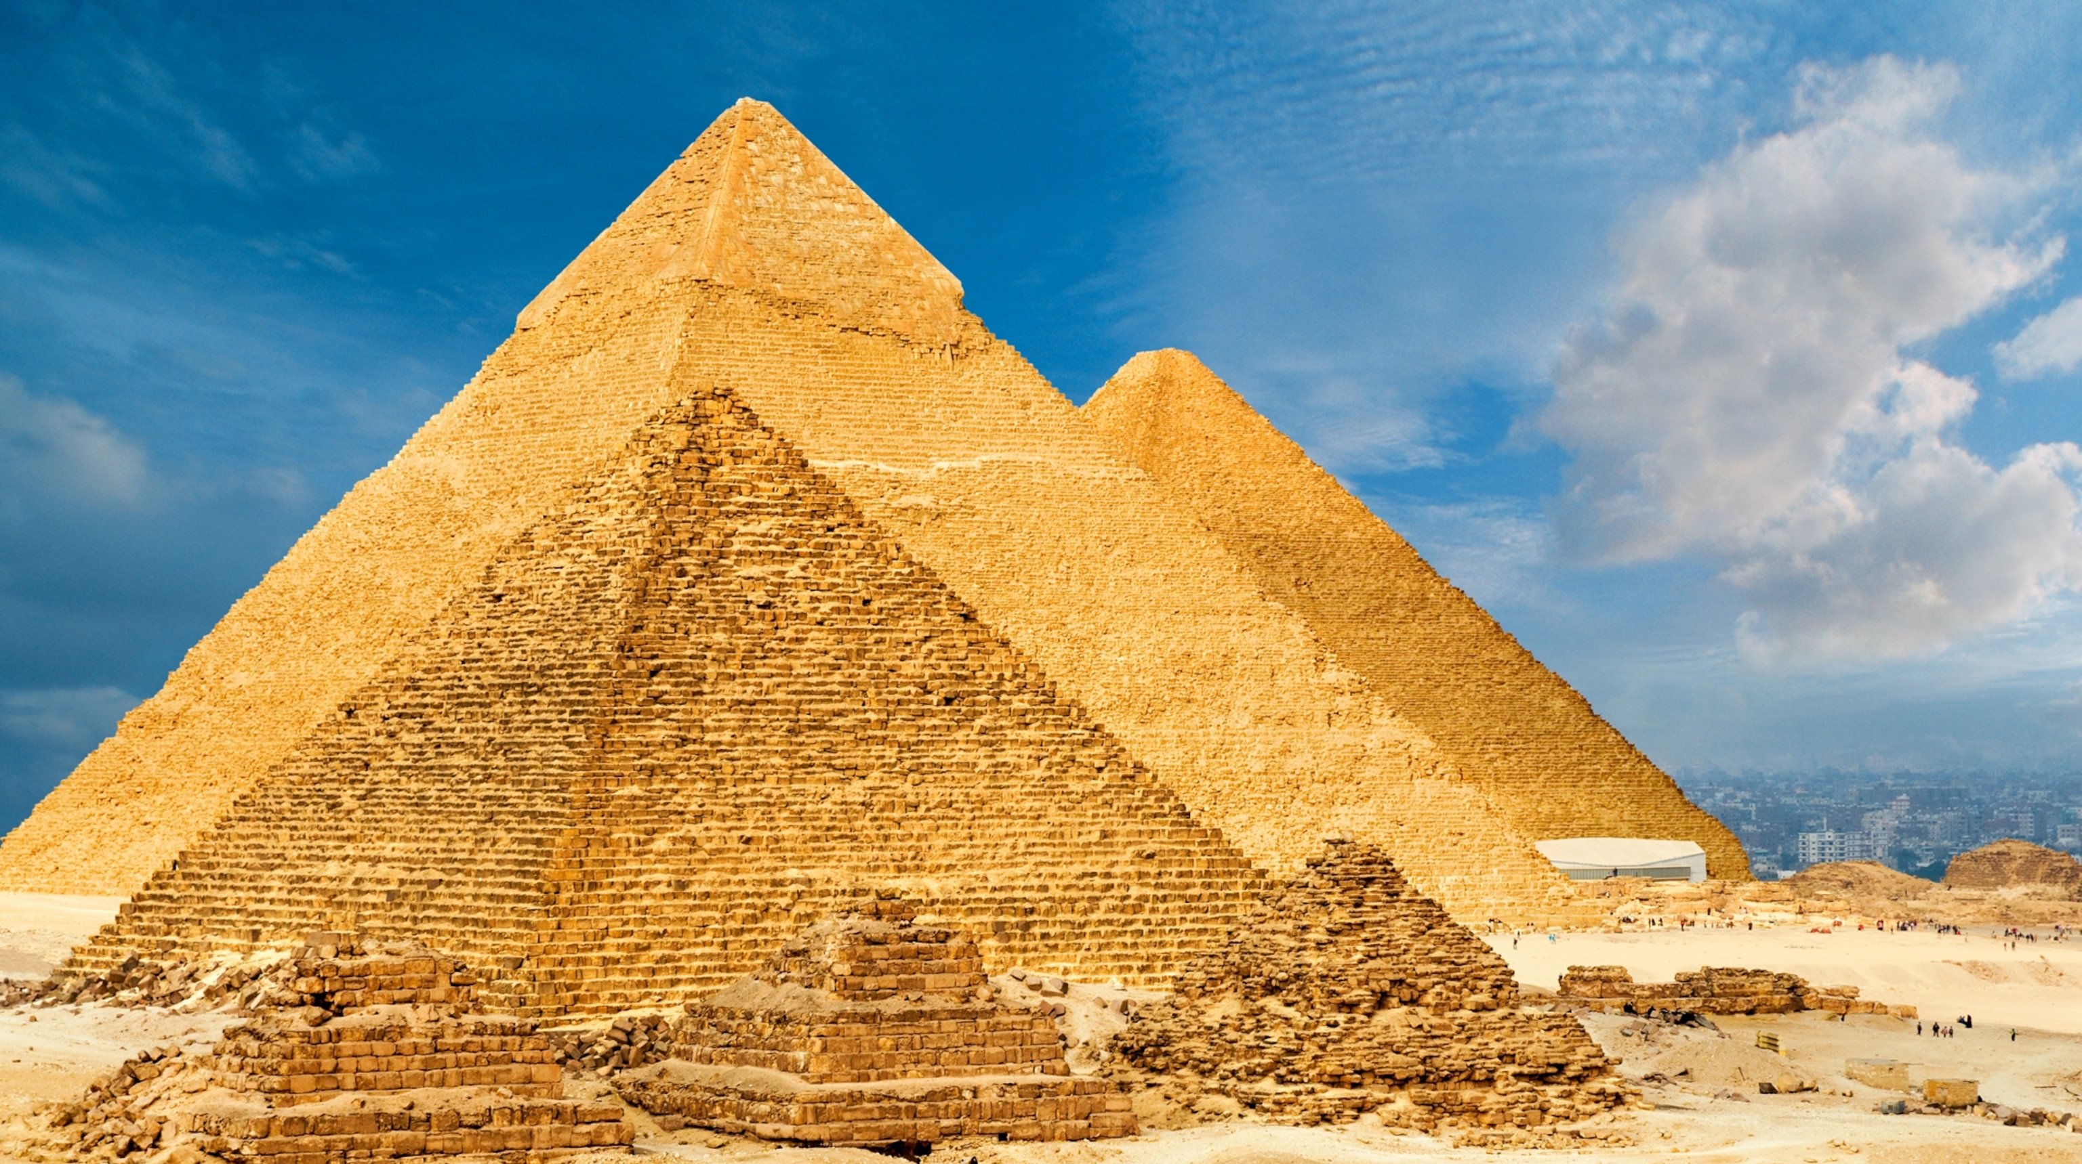
Categories to choose from include:
The Era of Dinosaurs
The Stone Age
Ancient Egypt

Slide 8
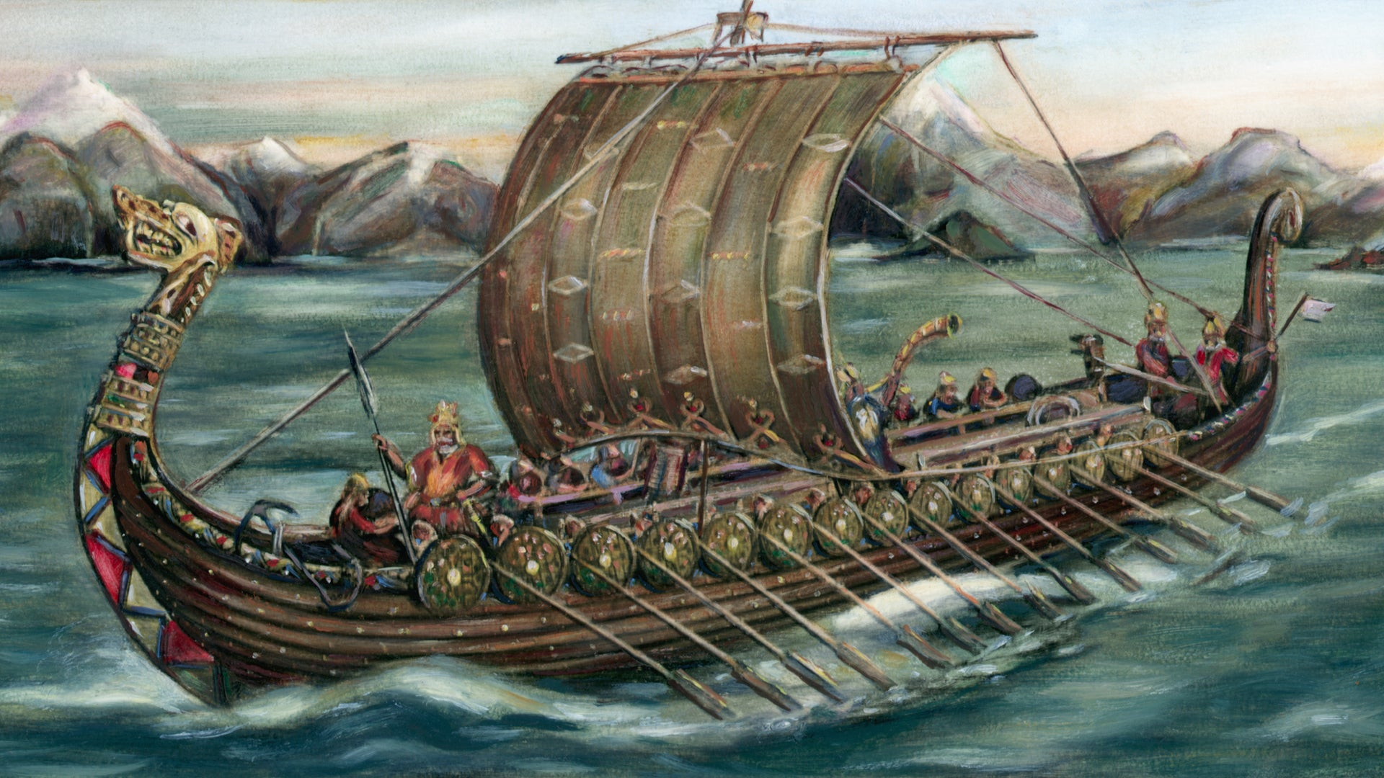
Categories to choose from include:
The Era of Dinosaurs
The Stone Age
Ancient Egypt
The Viking Era

Slide 9
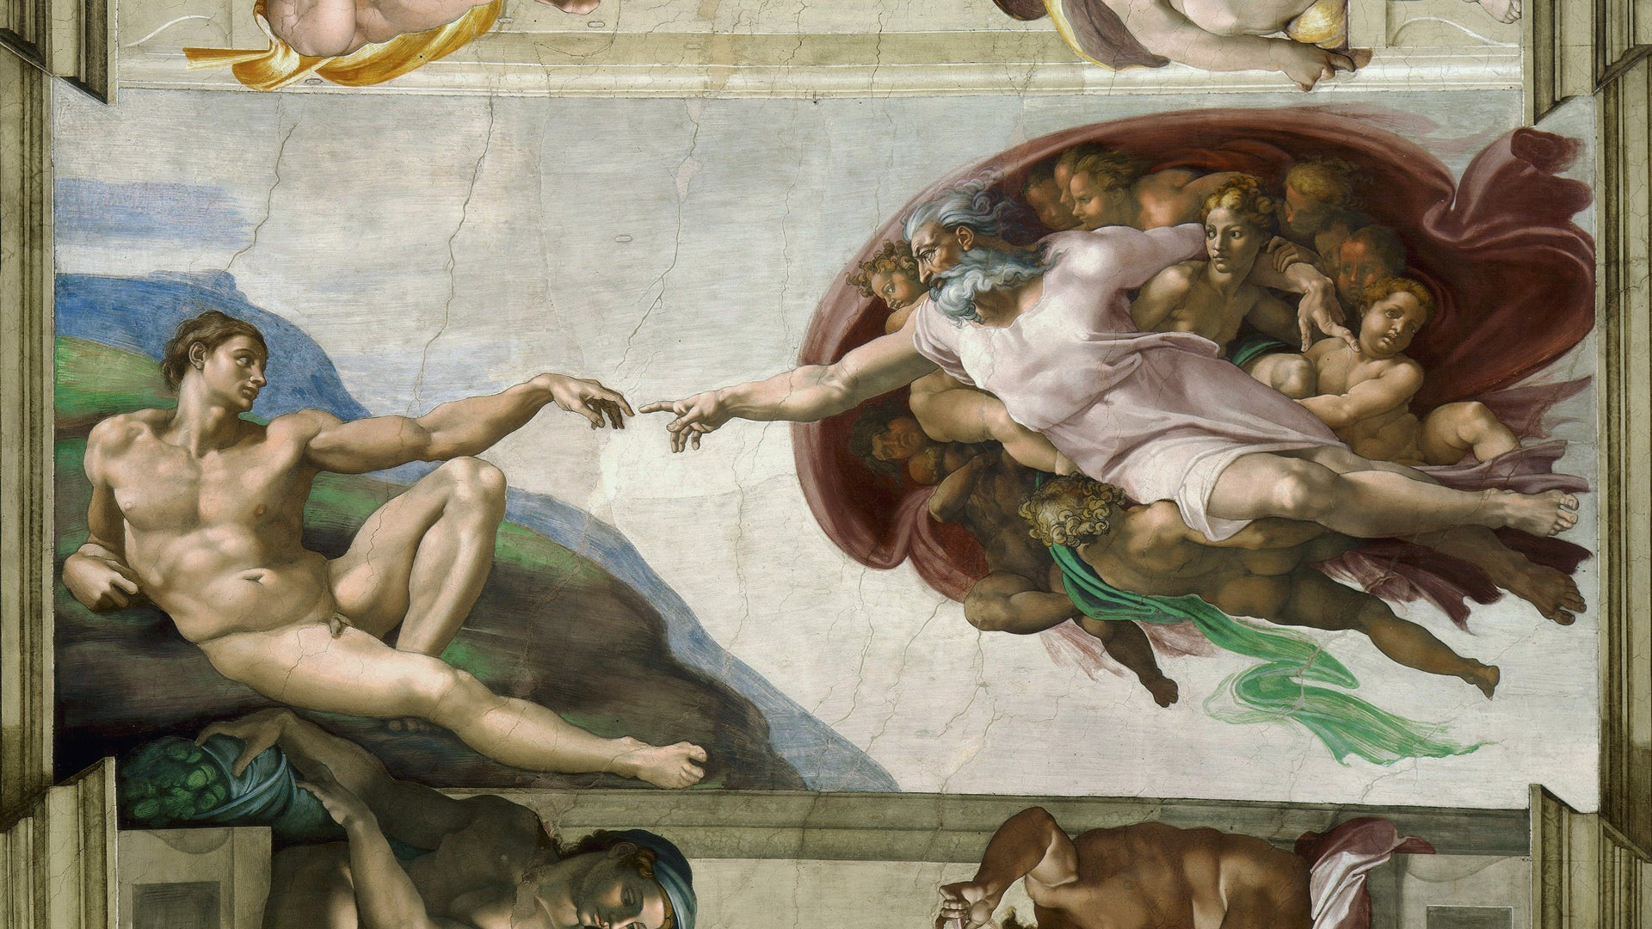
Categories to choose from include:
The Era of Dinosaurs
The Stone Age
Ancient Egypt
The Viking Era
The Renaissance

Slide 10
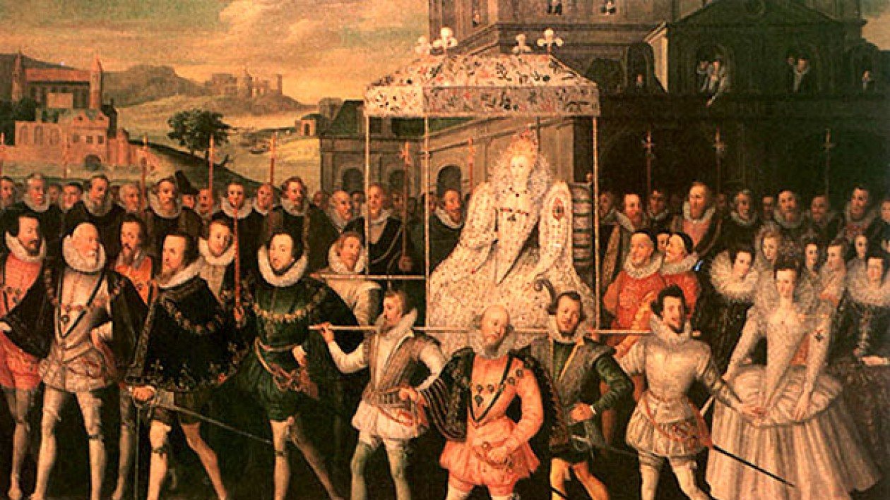
Categories to choose from include:
The Era of Dinosaurs
The Stone Age
Ancient Egypt
The Viking Era
The Renaissance
The Elizabethan Era

Slide 11
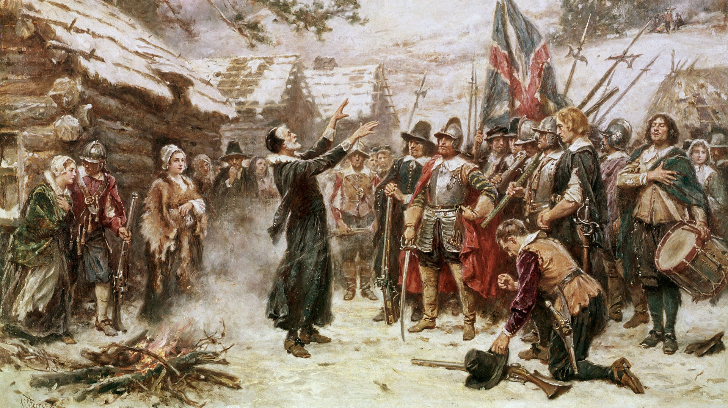
Categories to choose from include:
The Era of Dinosaurs Pilgrims’ & New World
The Stone Age
Ancient Egypt
The Viking Era
The Renaissance
The Elizabethan Era

Slide 12
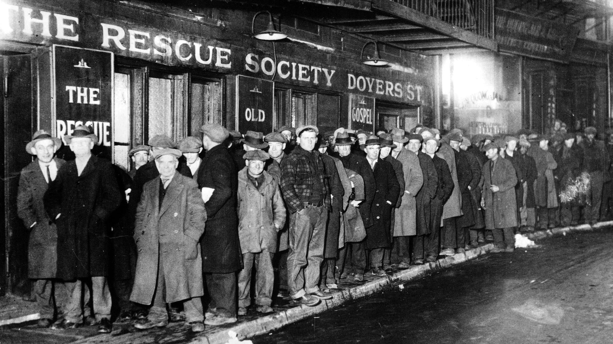
Categories to choose from include:
The Era of Dinosaurs Pilgrims’ & New World
The Stone Age 1900s, 10s, 20s, 30s
Ancient Egypt
The Viking Era
The Renaissance
The Elizabethan Era

Slide 13
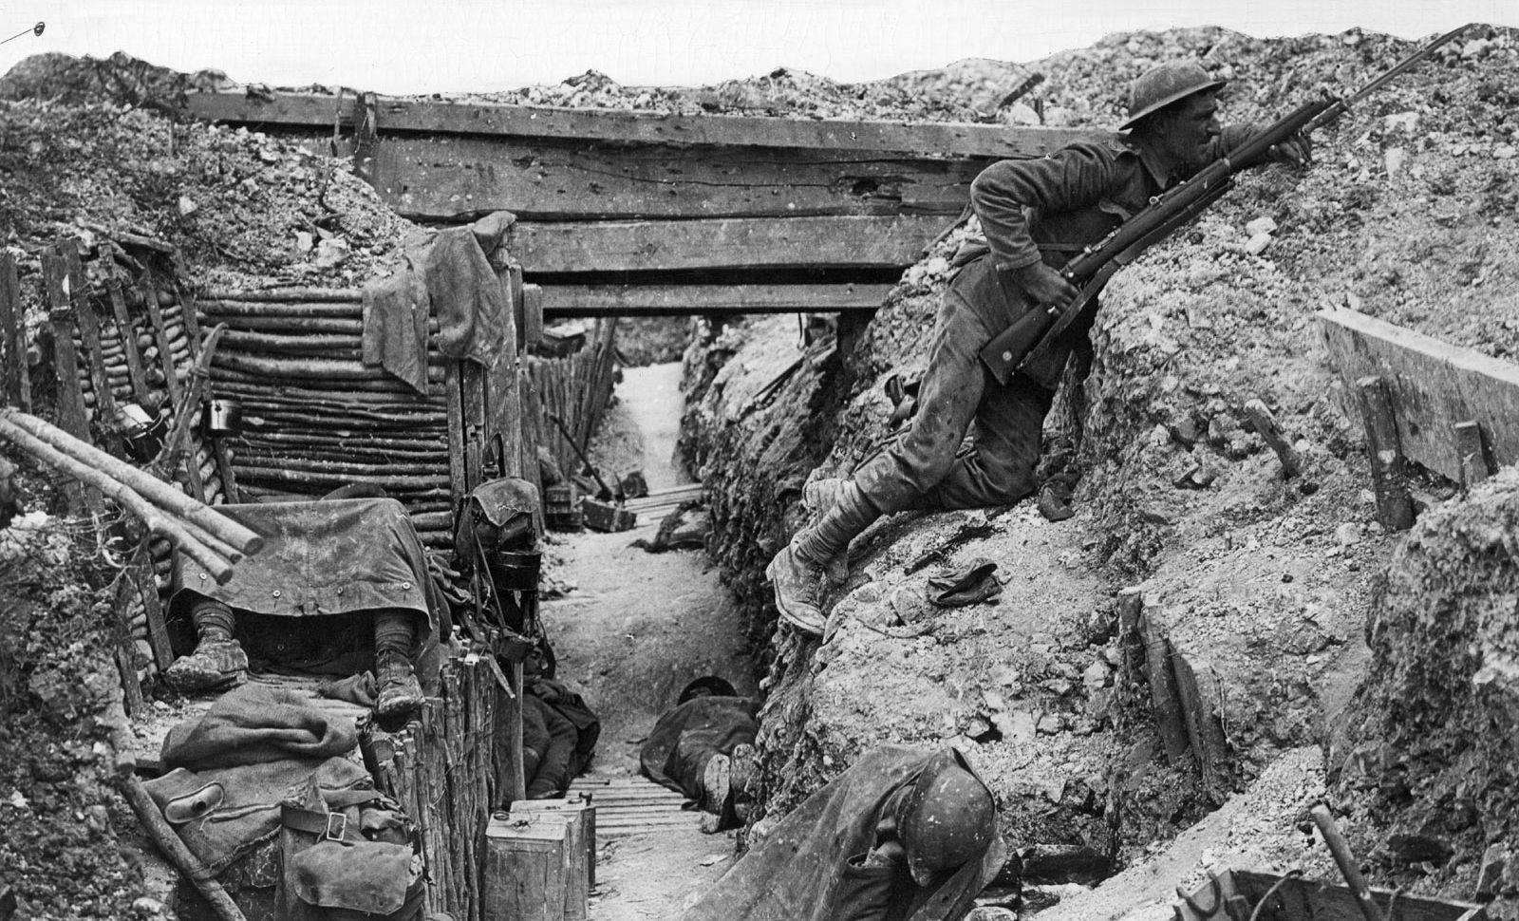
Categories to choose from include:
The Era of Dinosaurs Pilgrims’ & New World
The Stone Age 1900s, 10s, 20s, 30s
Ancient Egypt World War I
The Viking Era
The Renaissance
The Elizabethan Era

Slide 14
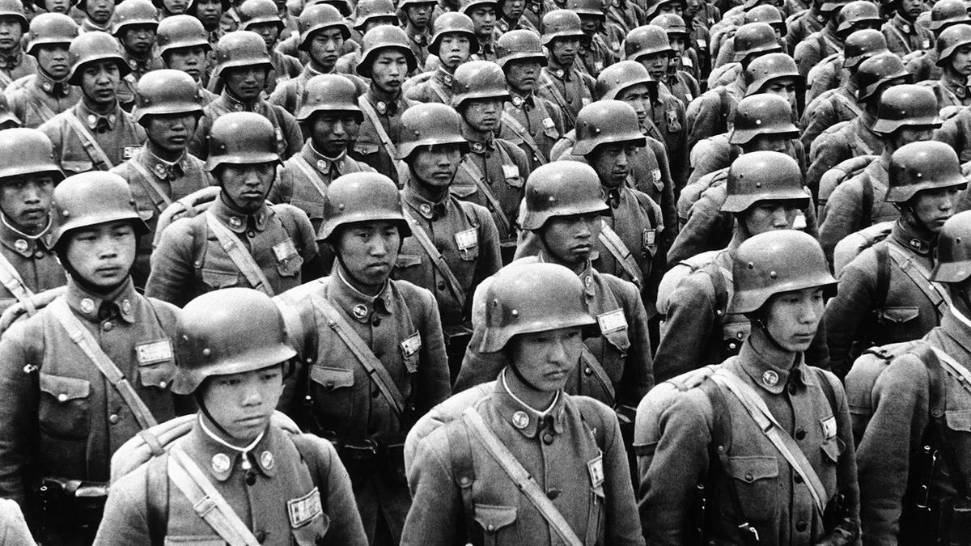
Categories to choose from include:
The Era of Dinosaurs Pilgrims’ & New World
The Stone Age 1900s, 10s, 20s, 30s
Ancient Egypt World War I
The Viking Era World War II
The Renaissance
The Elizabethan Era

Slide 15
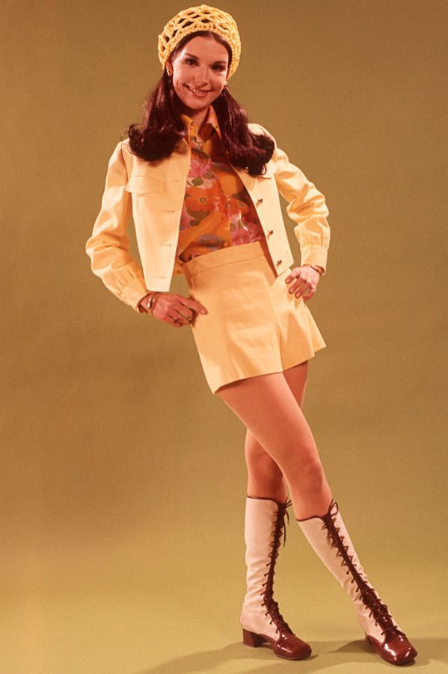


Categories to choose from include:
The Era of Dinosaurs Pilgrims’ & New World
The Stone Age 1900s, 10s, 20s, 30s
Ancient Egypt World War I
The Viking Era World War II
The Renaissance The 50s, 60s, 70s, 80s, & 90s
The Elizabethan Era

Slide 16
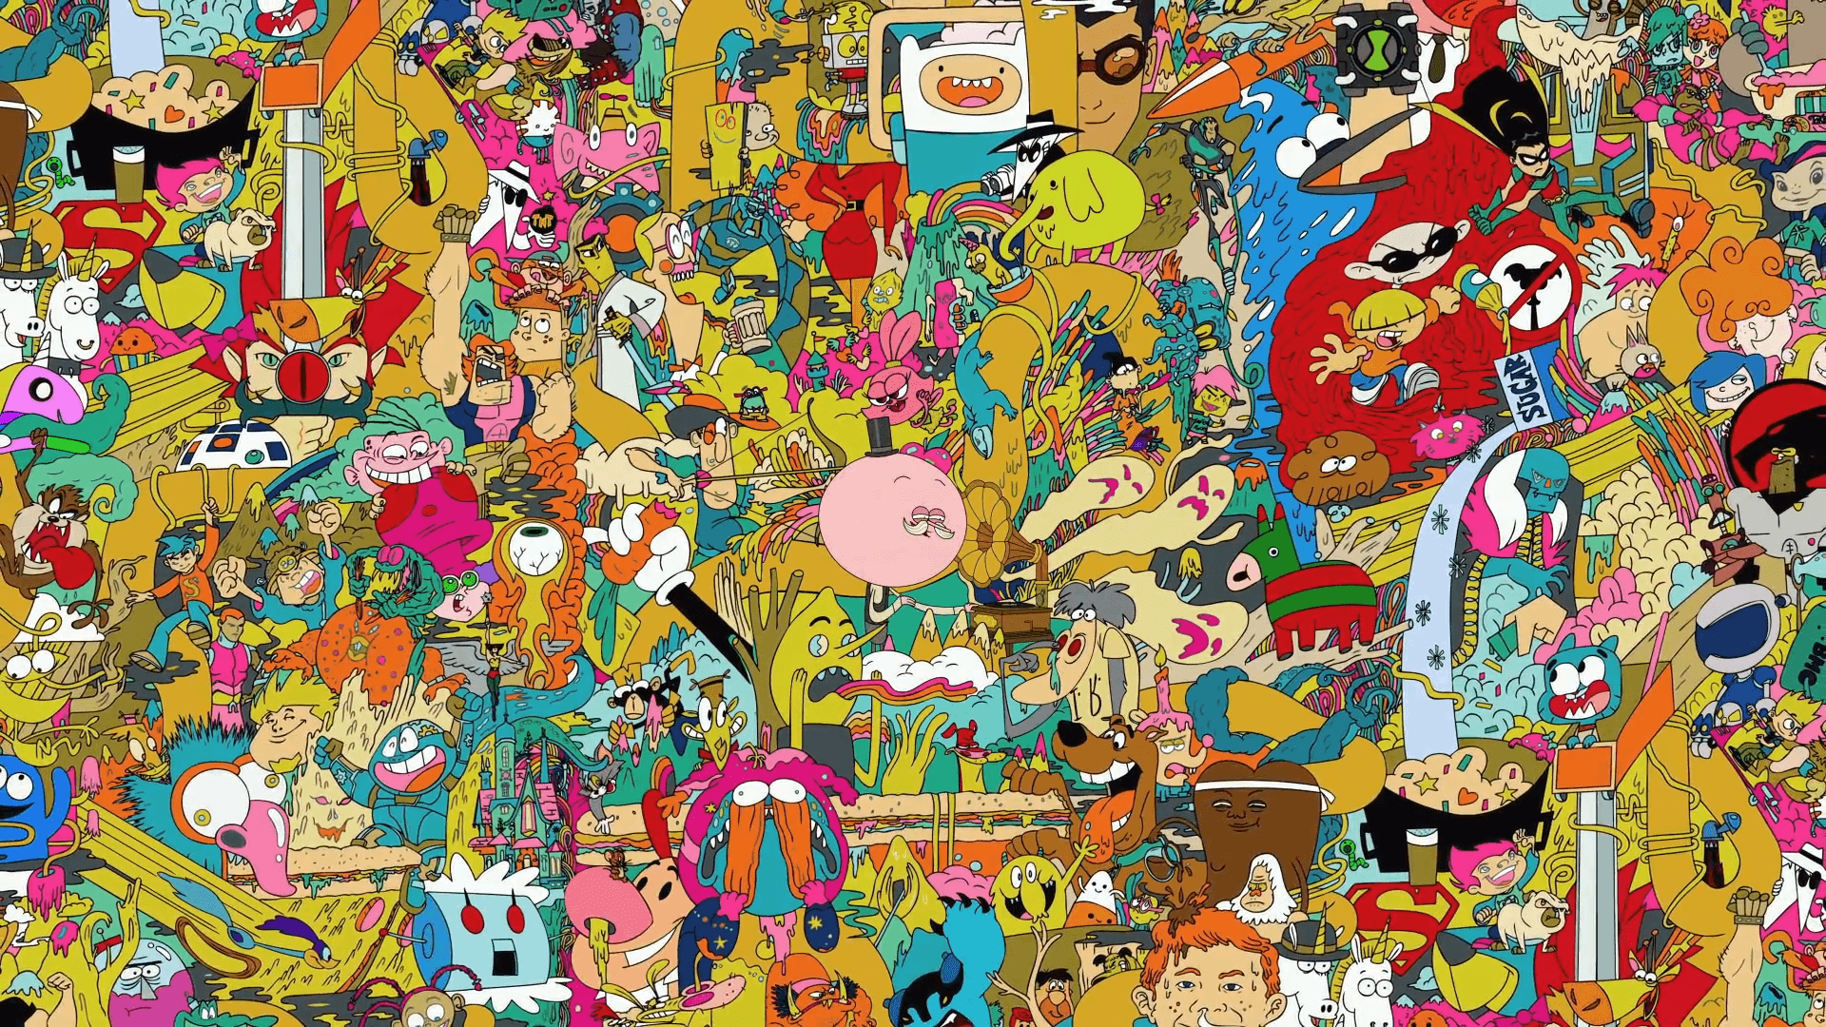
Categories to choose from include:
The Era of Dinosaurs Pilgrims’ & New World
The Stone Age 1900s, 10s, 20s, 30s
Ancient Egypt World War I
The Viking Era World War II
The Renaissance The 50s, 60s, 70s, 80s, 90s
The Elizabethan Era The 2000s

Slide 17

Categories to choose from include:
The Era of Dinosaurs Pilgrims’ & New World
The Stone Age 1900s, 10s, 20s, 30s
Ancient Egypt World War I
The Viking Era World War II
The Renaissance The 50s, 60s, 70s, 80s, 90s
The Elizabethan Era The 2000s
The Present

Slide 18
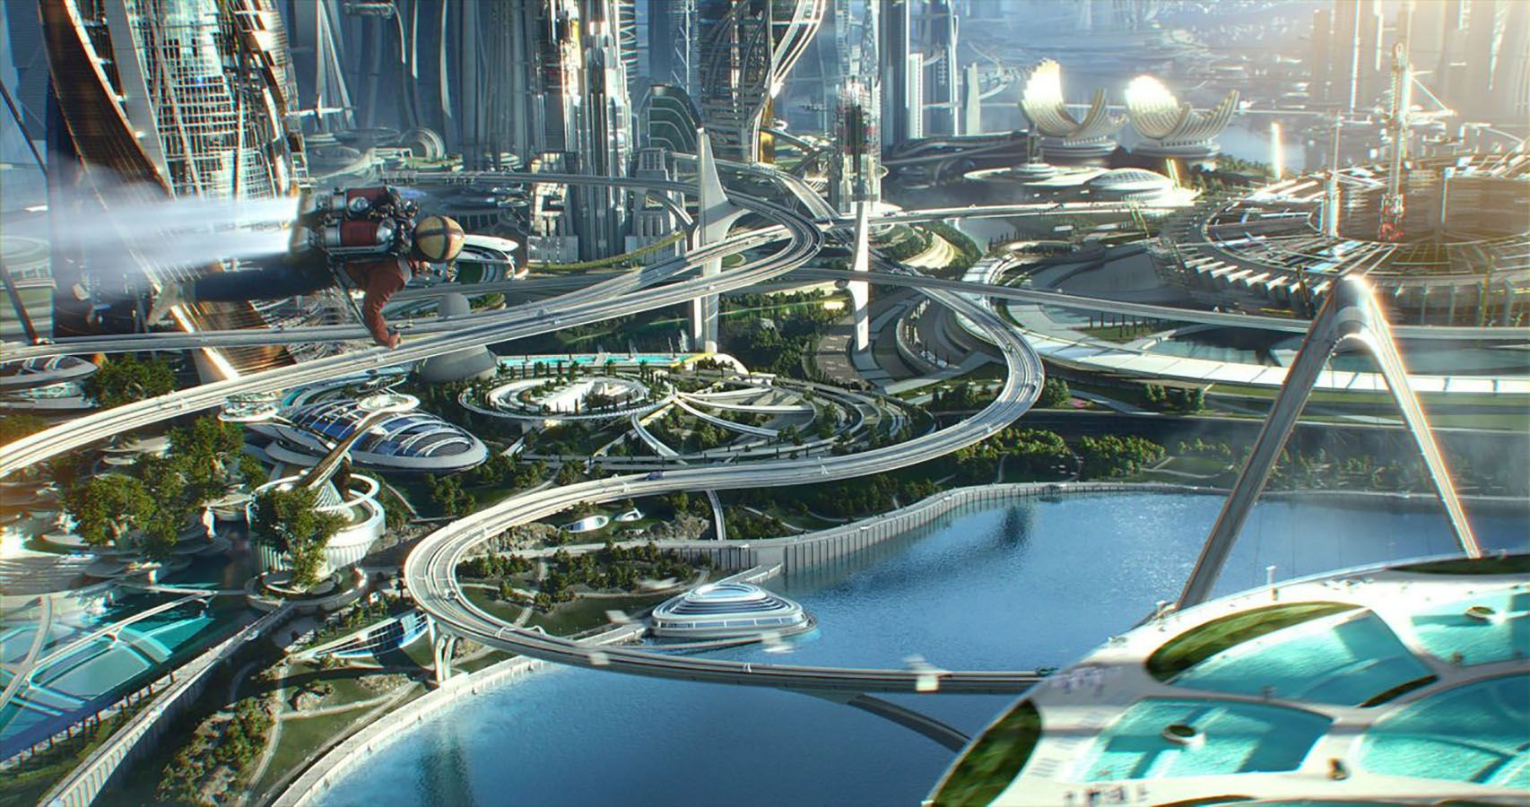
Categories to choose from include:
The Era of Dinosaurs Pilgrims’ & New World
The Stone Age 1900s, 10s, 20s, 30s
Ancient Egypt World War I
The Viking Era World War II
The Renaissance The 50s, 60s, 70s, 80s, 90s
The Elizabethan Era The 2000s
The Present
The Future

Slide 19

<[/IMPLEMENTATION OF JAVA]>
This game was developed using Java scripts.

Slide 20
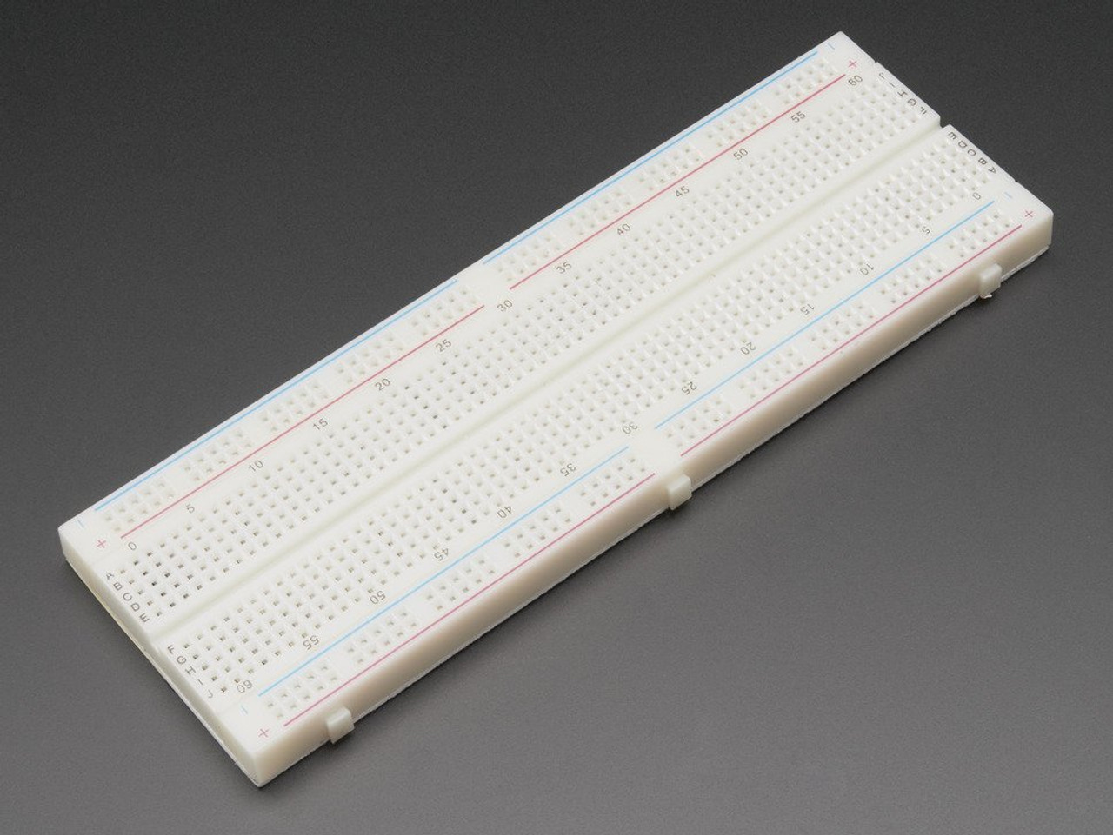
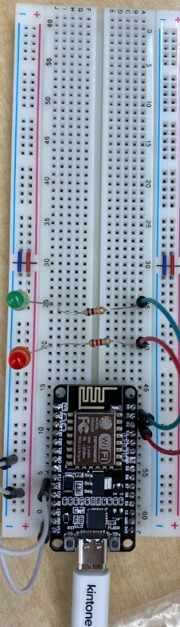
IMPLEMENTATION OF BREADBOARD CICRUITS
The game is connected to a breadboard ECB8266 setup. When connected, the green light will light up when a player guesses correctly, and if wrong, the red light will light up.

Slide 21
CONCLUSION
Play our game TIMETRAVLR!
(ChatGPT was used to help with some parts of this project)

